Slide 1
GENERAL INFORMATION ABOUT LITHUANIA
Project “Welcome to the business land“,
LT-PL-2S-190
BUSINESS IN LITHUANIA

Slide 2
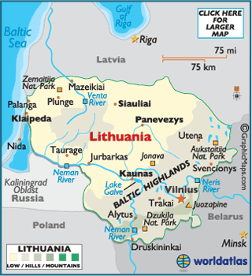
FACTS ABOUT LITHUANIA
Area: 650 200 sq. km.
Neighbors:
Latvia (land border – 588 km, sea border – 22 km)
Byelorussia (border – 677 km)
Poland (border – 104 km)
Russia (Kaliningrad) (land border – 255 km,
border in Curonian sea – 18 km, sea border– 22 km)

Slide 3
Facts about lithuania
Language: Official language– Lithuanian, which is the member of Baltic language group (other 2 members are Latvian, and dead Prussian language). It is the most archaic language from all the Indo-European languages.
Religion: Lithuania is considered to be very religious country: around 79 percent of Lithuanians consider themselves as Roman Catholics.
Currency: Euro
Political system: Lithuanian Republic is the parliamentary democracy. The head of state is The President. Executive authority is Prime minister and the cabinet, and the legislative power is in the hands of Seimas (the parliament)

Slide 4
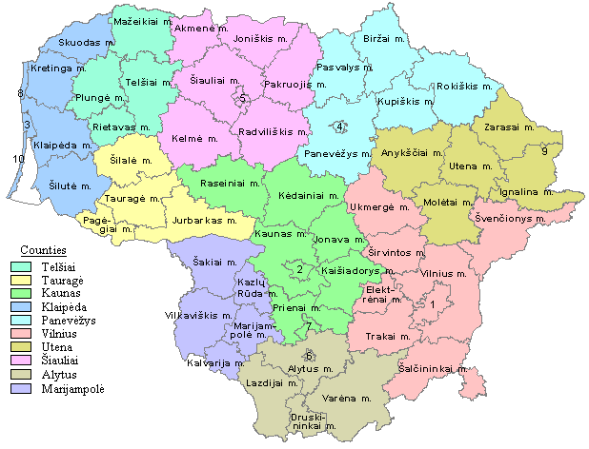
Administrative division
Lithuania is divided in 10 counties, that are subdivided into 60 municipalities governed by mayors which starting from 2015 are directly elected for four-year term. Municipalities are divided into 546 townships.
Cities:
The biggest cities in Lithuania:
Vilnius – 541 824 pop.
Kaunas – 360 637 pop.
Klaipėda – 187 316 pop.

Slide 5
Participation in international organizations
Lithuania joined NATO on 29 March 2004.
On 1 May 2004, Lithuania became a full member of the European Union, and joined the Schengen Area on 21 December 2007.
In June 2015, the Lithuanian delegation received an official invitation to start accession process to the organisation for Economic Cooperation and Development (OECD). The first positive opinion was issued by the OECD Trade Committee on 22 April 2016.
The Lithuanian authorities are in process of an intense technical accession, which is expected to be completed during 2018.

Slide 6
counties according number of residents
 |  | Number of residents
 |  | 2014 | 2015 | 2016 | 2017 | 2018
Vilnius county | City | 633652 | 635732 | 635174 | 635086 | 635886
 | Countryside | 172454 | 171791 | 170206 | 170087 | 169481
Alytus county | City | 87318 | 86170 | 84362 | 81671 | 79413
 | Countryside | 62533 | 61639 | 60747 | 59945 | 58682
Kaunas county | City | 411924 | 408179 | 403092 | 395001 | 388003
 | Countryside | 175314 | 174868 | 174266 | 174874 | 175109
Klaipėda county | City | 235017 | 233569 | 231111 | 226140 | 222119
 | Countryside | 93996 | 93731 | 93507 | 94367 | 95133
Marijampolė county | City | 75932 | 74806 | 73342 | 71214 | 69127
 | Countryside | 78152 | 76987 | 75735 | 74146 | 72160
Panevėžys county | City | 142047 | 140234 | 137800 | 133824 | 130112
 | Countryside | 96701 | 95160 | 93201 | 91209 | 88614
Šiauliai county | City | 178435 | 176446 | 173729 | 169928 | 167491
 | Countryside | 107328 | 105186 | 102600 | 100554 | 97976
Tauragė county | City | 44109 | 43687 | 43158 | 41883 | 40714
 | Countryside | 60514 | 59396 | 58042 | 56725 | 55103
Telšiai county | City | 86953 | 85908 | 84574 | 81817 | 79445
 | Countryside | 58529 | 57603 | 56719 | 55952 | 54694
Utena county | City | 79193 | 77882 | 76886 | 74504 | 72412
 | Countryside | 63371 | 62288 | 60307 | 58977 | 57227
Lithuania‘s population is currently in decline, losing about 1.5% of its population per year. The country has now reached its lowest population in decades as more people emigrate to wealthier west European countries

Slide 7
The structure of residents according age
At the beginning of 2018, the number of children (aged 0–14) was 1.3 times lower than that of elderly people (aged
65 and older). The proportion of children in the total resident population made up 15, that of elderly people –19.6 per cent.

Slide 8
Index of ageing
At the beginning of 2018 , the “oldest” counties were Utena, Alytus and Panevėžys counties, where elderly people made up 22.4–23.9 per cent the total resident population of those counties.

Slide 9
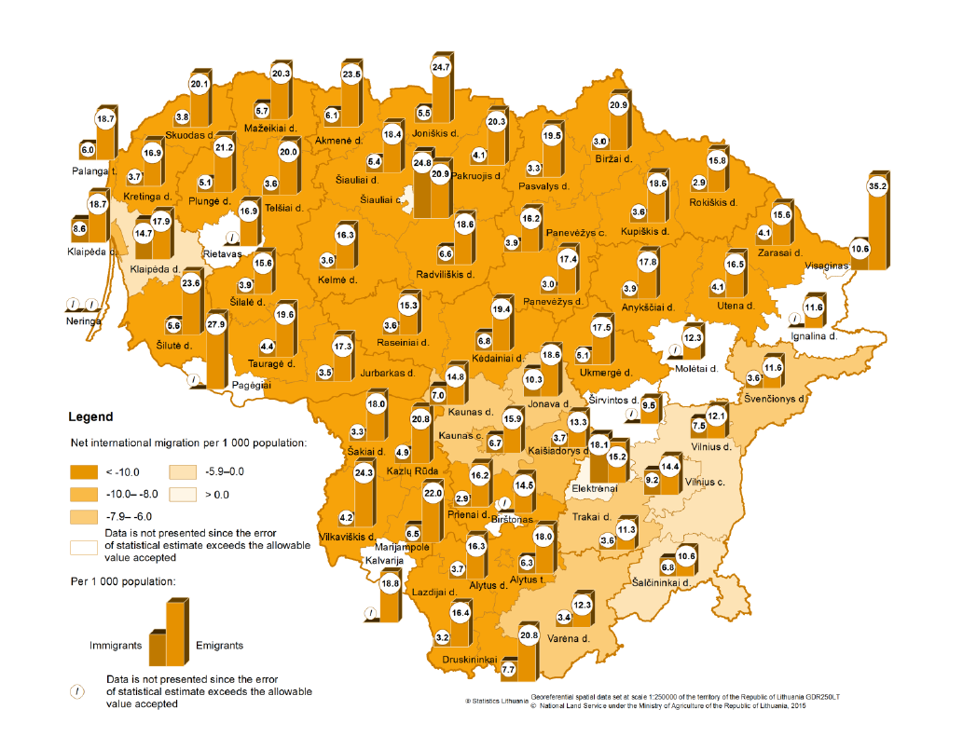
International immigration of residents
In 2017, 47.9 thousand residents emigrated from Lithuania (4.8 per cent less than in 2016 m.). The crude emigration rate (the number of emigrants per 1 000 population) stood at 16.9. The highest number of emigrants per 1 000 population was in Marijampolė county (21.4), in Šiauliai and Telšiai counties the crude emigration rate was 20.2. The lowest – in Vilnius county (13.8).

Slide 10
Accessibility - Infrastructure
Lithuania is situated at the heart of Europe, thus making it easy and convenient to access other European cities.
There are four international airports in Lithuania, which offer direct flights of up to three hours to the main business destinations.
The road network of Lithuania is also well developed. Lithuania has more than 71 thousand kilometres of roads whereof 91% are paved roads.

Slide 12
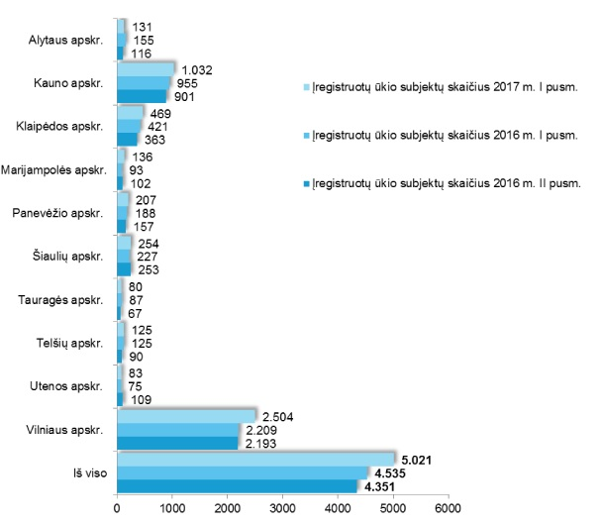
New economic entities registered
As of 1 January 2018, there were 104 117 economic entities in operation in Lithuania (46 per cent of all economic entities registered in the Register of Legal Persons). Over the year, the number of economic entities in operation remained almost unchanged.
Almost a quarter (23.8 per cent) of economic entities were engaged in wholesale or retail trade, repair of motor vehicles and motorcycles. Over 80 per cent of economic entities in operation had less than 10 employees; such economic entities employed 17.9 per cent of all the persons employed in the country.
The average annual income of most of the economic entities operating in the country does not exceed EUR 0.3 million. Meanwhile, economic entities earning more than EUR 40 million a year make up 0.2 per cent.
In 2017, 11 345 new economic entities were registered in Lithuania, unregistered – 4674.

Slide 13
Number of bankruptcy processes completed
 | Number of bankruptcy processes completed during the corresponding year | number
 | 2013 | 2014 | 2015 | 2016 | 2017
Republic of Lithuania | 1450 | 1607 | 1858 | 2203 | 2869
Vilnius county | 556 | 634 | 758 | 1010 | 1217
Alytus county | 47 | 51 | 51 | 63 | 85
Kaunas county | 262 | 308 | 354 | 378 | 612
Klaipėda county | 222 | 235 | 286 | 299 | 372
Marijampolė county | 39 | 31 | 39 | 65 | 61
Panevėžys county | 90 | 84 | 90 | 105 | 146
Šiauliai county | 117 | 132 | 150 | 154 | 205
Tauragė county | 24 | 30 | 33 | 25 | 13
Telšiai county | 32 | 36 | 54 | 72 | 81
Utena county | 61 | 66 | 43 | 32 | 77
Bankruptcies in Lithuania increased to 2869 Companies in 2017 from 2203 Companies in 2016. Bankruptcies in Lithuania averaged 1346.71 Companies from 2001 until 2017, reaching an all time high of 2869 Companies in 2017 and a record low of 590 Companies in 2001.

Slide 14
Attractive sectors
Information and communication technology sector is one of the highly prioritised and most promising sectors in Lithuania. Over 31,500 IT professionals in Lithuania are working in this sector. Modern technologies (such as EDGE technology, 4G mobile communications infrastructure and mobile WiMAX 4G Internet), the fastest public Wi-Fi in Europe and the greatest fibre-optic (FFTH) Internet network penetration in Europe – all these factors make Lithuania especially attractive for offshore services.
Lithuania’s engineering industry has been constantly growing and expanding by approximately 15% every year since 2009. This industry is highly competitive in terms of cost and quality and it is well-integrated into the global supply chains. Products developed by the Lithuanian engineers are often adapted by such international companies and organisations as NASA, Boeing, U.S. Army, BMW, Volkswagen, Hitachi, Siemens and Mitsubishi.
Biotechnology research takes place in Lithuania, and the developed techniques and products are applied in the fields of medicine, pharmacy, chemistry, agriculture, environment, etc. Lithuania’s biotechnology products are recognised worldwide, as 90% of them are exported to over 100 countries. The main export markets include the USA, Japan, Israel, Germany and the United Kingdom. The sector grows on average by 25% annually.

Slide 15
Attractive sectors
Laser technologies: Lithuania accounts for more than half of the global market of picosecond laser speedometers. A world-class quality of laser production has been recognised by nearly 100 countries importing over 90% of the Lithuanian laser production. Such companies and organisations as NATO, Pentagon, Nuclear Research Centre in Israel, Rezerford Laboratories in England, Berkley University, Livermore National Laboratory are the clients of the Lithuanian companies producing lasers. The sector grows on average by more than 10% annually.
The Fintech sector falls among the most promising and growing sectors in Lithuania. It is highly supported and promoted by authorities at both national and municipal levels by the introduction of Fintech-friendly regulations, including the regulations on the obtainment of an e-money or payment license that is 2–3 times faster than in other EU jurisdictions. Direct access to SEPA can be gained via a Bank of Lithuania API. It is also possible to issue your own IBANs. Up to 10 Fintech start-ups were established in Vilnius over the last year. Such companies as Barclays, Western Union, deVere Group, Nasdaq, Revel Systems and other have already chosen Lithuania as one of their go-to places to do business.
Renewable energy development is becoming increasingly important for Lithuania’s export, too.

Slide 16
Economic specialisation of the regions (Business Guide Lithuania 2018)
The Klaipėda region is positioning itself as a blue growth region (i.e. the region will be focusing on the long term strategy to support sustainable growth in the marine and maritime sectors),
the Marijampolė region is ready to work with investors in wood, food and metal industries,
Panevėžys aims at becoming the hub of robotics, etc.

Slide 17
sources
Business guide Lithuania 2018. PricewaterhouseCoopers UAB.
Statistics Lithuania. https://www.stat.gov.lt/home
Invest Lithuania. https://investlithuania.com/investor-guide/economic-overview/

Slide 18
About the project
The project “Welcome to the business land“ (LT-PL-2S-190) is aimed at showing the border region youth that Business can be simple, if you have a good idea, some support from professionals and general knowledge on business processes. During its implementation, it is planned to organize business leader’s competition and International Economic Forum and to activate partnership of project beneficiaries and social partners (schools, business companies, professional development centers).
This training material has been produced with the financial assistance of the European Union. The contents of this training material are the sole responsibility of PI PVC and “Euroregion Niemen” Association and can under no circumstances be regarded as reflecting the position of the European Union.
Total projects size is 49 973, 25 EUR. Out of them co-funding of European Regional Development Fund is 42 477,25 EUR.
This project is Partly financed from the European Regional Development Fund
Interreg V-A Lithuania-Poland cooperation programme
www.bonusLT-PL.eu

